Slide 1
CRM – Presentation
César DE OLIVEIRA
iCDG Telephony FT
1st August 2016 – draft 0.07

Slide 2
CRM Presentation – agenda
CRM Presentation
  Design overview
    Architecture
    MSCs
    FSMs
    Threading model
  Firmware upgrade
  Source code
  Debug
    Logging
    Test apps
  TCS2

Slide 3
CRM Presentation

Slide 4
CRM - presentation
CRM stands for “Connectivity Resource Manager”
CRM purpose
Starts/stops/resets the modem according to client needs (resource handling)
Handling modem FW update and modem customization.
Notifies modem state to its clients (UP, DOWN, OOS)
Handles modem crashes
Synchronizes the startup of modem clients with modem readiness for communication including RPC daemon readiness.
CRM capacity
Supports several types of modems
Runs on linux-based OS

Slide 5
CRM - presentation

Slide 6
Design overview
Architecture

Slide 7
CRM – design overview
MODULARITY
    CRM is composed of plugins
    Loaded at runtime
    New platform = a sub-set of new plugins only
COMMUNICATION between modules
  Asynchronous function calls
  Functions shall be non blocking
  RPC like: result of previous request MUST be received before sending a new request

Slide 8
CRM – design overview
PURPOSE
Handles communication with clients
  Registration
  Requests
  Events
Virtual client
  Combines multiple client requests as if Control has a single client
TECHNICAL DETAILS
FSM
Thread
Generic plugin

Slide 9
CRM – design overview
PURPOSE
Loads all plugins
Decision maker according to all events received from the modules
TECHNICAL DETAILS
FSM
Thread
Generic plugin

Slide 10
CRM – design overview
PURPOSE
Detects control deadlocks: PING/PONG
Time keeper during transitions
TECHNICAL DETAILS
Thread
Generic plugin

Slide 11
CRM – design overview
PURPOSE
Bridge between C and Android Java world
Used to
  Acquire/release wakelocks
  Broadcats intents (platform reboot, telephony event notifier)
TECHNICAL DETAILS
Generic plugin

Slide 12
CRM – design overview
PURPOSE
Selects the firmware to flash
Provides a list of TLV if customization is needed
TECHNICAL DETAILS
Generic plugin

Slide 13
CRM – design overview
PURPOSE
Defines the recovery strategy (warm, cold reset, platform reboot, modem out of service)
TECHNICAL DETAILS
Generic plugin

Slide 14
CRM – design overview
PURPOSE
Reads modem core dump and stores it in file system
TECHNICAL DETAILS
Thread or Thread+Process
Platform specific plugin

Slide 15
CRM – design overview
PURPOSE
Customizes the modem on the fly by sending TLV files content
TECHNICAL DETAILS
Thread
Platform specific plugin

Slide 16
CRM – design overview
PURPOSE
Packages the modem firmware
Uploads the modem firmware
TECHNICAL DETAILS
Thread or Thread+Process
Platform specific plugin

Slide 17
CRM – design overview
PURPOSE
Abstracts IPC and physical control of the modem
  Notifies modem state to control according to HW events
Controls the NVM server
Controls the RPC daemon
TECHNICAL DETAILS
FSM
Threads
Platform specific plugin
SPECIFICITIES
No success/failure request verdict
A request can be sent without waiting for the result of the previous one
Notification is event based
MDM_BUSY is always followed by a second event providing the reason (OFF, DUMP, FLASHING, UNRECOVERRABLE)

Slide 18
CRM – design overview
PURPOSE
Controls the NVM server, used to sync NVM data in filesystem
TECHNICAL DETAILS
Thread + process
Platform specific plugin

Slide 19
Design overview
Threading model

Slide 20
CRM – threading model

Slide 21
Design overview
MSCs : some use cases

Slide 22
CRM – design overview
CLA state
Control state
MSC: modem power on sequence
with firmware upgrade

Slide 23
CRM – design overview
MSC: AP reset

Slide 24
CRM – design overview
MSC: core dump

Slide 25
Design overview
FSMs: some examples

Slide 26
CRM – design overview
FSM: Client Abstraction (CLA)
FSM: Control

Slide 27
CRM – design overview
FSM: HAL SoFIA
FSM: HAL PCIE

Slide 28
Firmware upgrade

Slide 29
CRM - Firmware upgrade

Slide 30
CRM - Firmware upgrade

Slide 31
Source code
Code organization

Slide 32
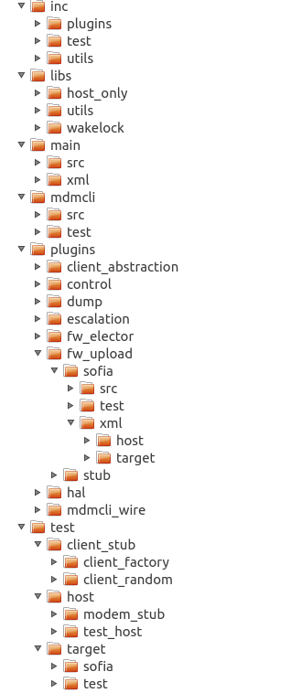
CRM – source code
CRM source code is split in different folders:
inc
  plugins: contains the headers of all plugins
  utils: contains the headers of CRM utils library. This library contains all shared code (file access, properties, logging, plugins, fsm, thread, etc).
  test: contains the headers used by unit test apps
libs: contains the source code of several shared libraries used by CRM (utils, wakelock, test host)
plugins: contains the source code of all plugins
main: main of CRM
mdmcli: CRM implementation of the client library
For each plugin, there is one folder per implementation and for each implementation, there is three folders (implementation, unit test and xml).

Slide 33
Debug

Slide 34
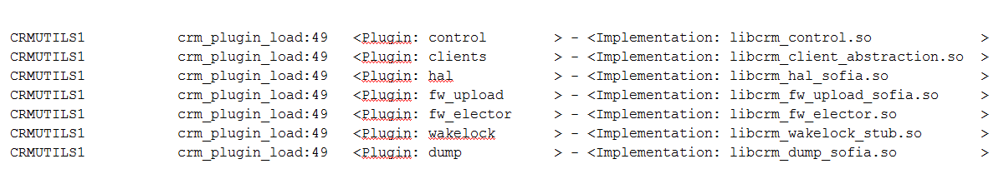
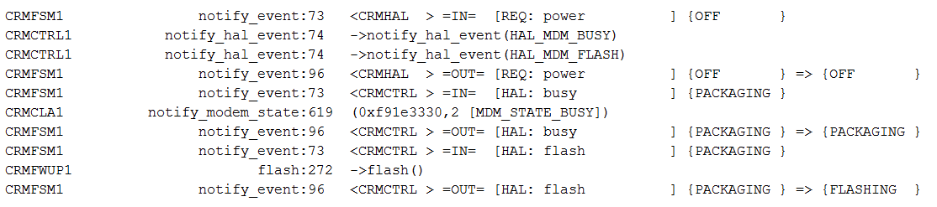
CRM – logging
CRM initialization
Component name
Function name
Name of the plugin to load
Plugin name
Line number
Name of the implementation
Instance id
FSM logging
Name of the FSM
entrance
Event received
Current state
New state
exit
Operation performed
(entry point of a plugin)
Callback
(providing the result of a request)

Slide 35
CRM – testing
3 kind of test applications
Plugin unit test
  Each plugin is tested with a unit test (Host or/and Target)
  Used to verify plugin behavior
Host test: crm_test_host
  Starts
    CRM
    Fake modem (controlled by the test app)
    Fake client (controlled by the test app)
  Used to
    Verify CRM behavior with defined scenarios
    Easily reproduce error use cases (modem crash, etc)
Target test: crm_test
  Starts CRM in sanity mode (only the test app is able to register)
  Used to
    Catch a regression before patch integration
    All classic UC are run by this test app
      Registration
      Resource handling
      APIMR
      Self reset
      Core dump
      Full escalation recovery
      etc

Slide 36
Libtcs2

Slide 37
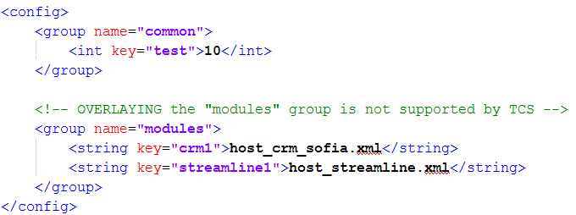
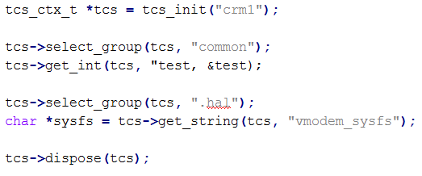
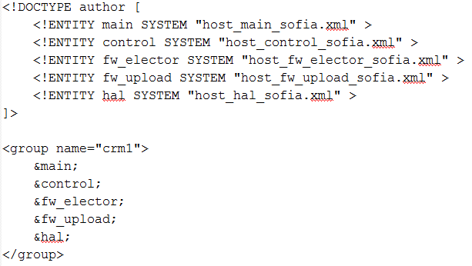
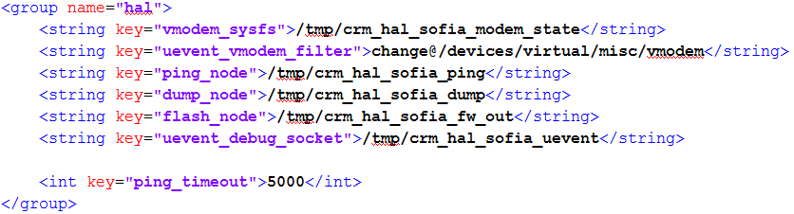
Libtcs2 – API and XML files
New API
New XMLs
➔ no backward compatibility
tcs_init() detects the platform and loads
needed XML files
Usage example:

Slide 38
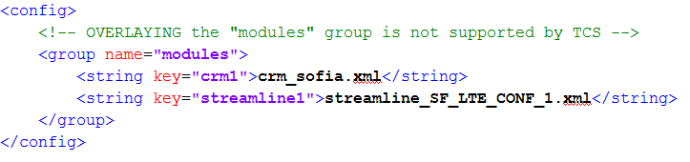
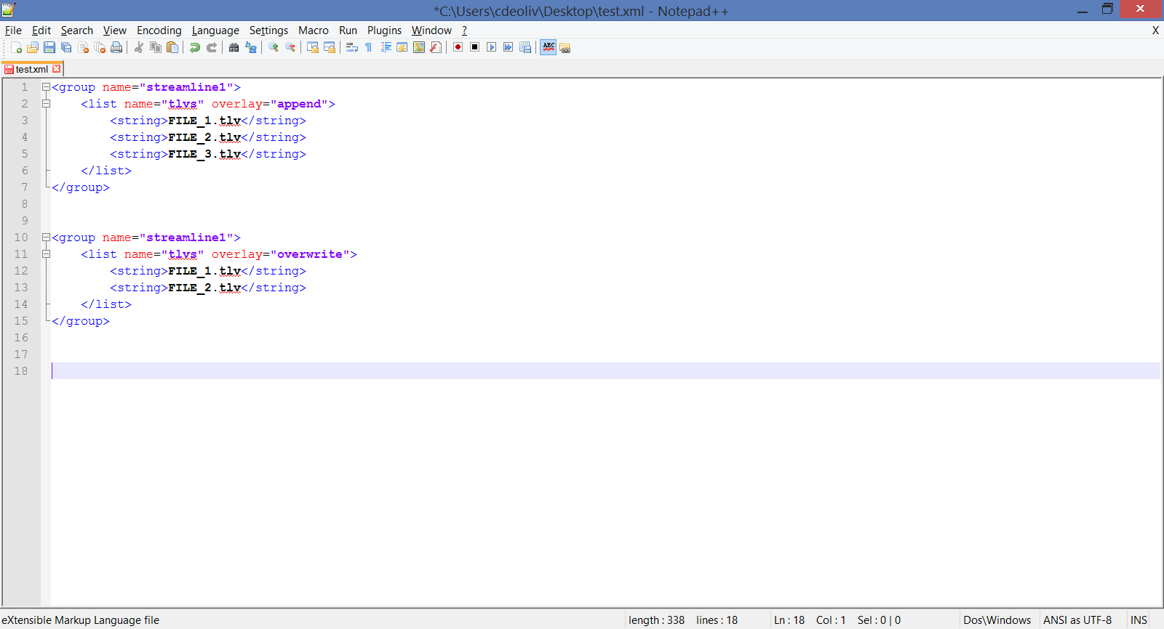
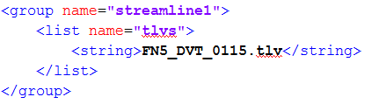
libtcs2 – XML files for streamline
Examples of overlay
List of TLV is appended to original one
List of TLV overwrites the original one
NB: append is the default behavior. Could be omitted
File: Hardware configuration file (ex: TCS_XMM7360_CONF1.xml)
Repo location: device/intel/common/telephony-config/hw_config/
Target location: /system/vendor/etc/telephony/tcs/config/
File: streamline_SF_LTE_CONF_1.xml
Repo location: device/intel/common/telephony-config/streamline/xmls/
Target location: /system/vendor/etc/telephony/tcs/streamline/
Repo location: device/intel/common/telephony-config/catalog/XXX/streamline/
Target location: /system/vendor/etc/telephony/catalog/XXX/streamline/
Name of XML file storing list of TLV files
Mandatory field used by CRM
Name of TLV file

